Slide 1
Lecture 13: Message Authentication Protocols
An Introduction to Information Security
School of Big Data and Software Engineering, CQU
Fall, 2018

Slide 2
Quickly Review
Lecture 12
Review of Security Services
Message Authentication(鉴别)
Message Authentication Code (MAC)
Cryptographic Hash Function
Requirements of Hash Function
MD5
SHA

Slide 3
More Application of Hash Function
A
B
M
H
MD
MD
M
H
MD’
Basic Usage: Message Digest

Slide 4
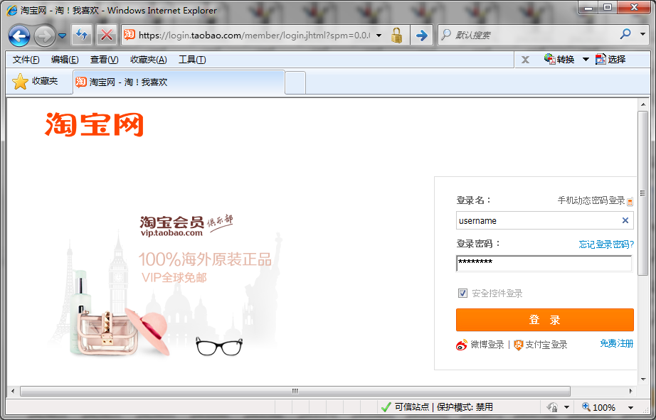


More Application of Hash Function
Server
User Table
Id1, user1, pass1
Id2, user2, pass2
Id3, user3, pass3
Id4, user4, pass4
…., ……., …...
Password Protection

Slide 5

More Application of Hash Function
Auth Server
张山
Hash(password)
张山
password
User Table
Id1, user1, #@&?
Id2, 张山, *&|!%
Id3, user3, $^~}.
Id4, user4, %*!；
…., ……., …...
Password Protection

Slide 6
More Application of Hash Function
User
Auth Server
Hash^{N-x}(seed)
N：一个很大的初始值, e.g., N=1000
x：为登录验证的次数
On time password
防止重放攻击
方法(之一)：
用户和Auth Sever秘密共享一个seed

Slide 7

Contents
1. Digital Signature
2. Authentication Protocols
3. Pretty Good Privacy

Slide 8
Locations
Slides p7-15 are talking about digital signature issue which can be found in section 13.1 of the text book

Slide 9
1.Digital Signature
A digital signature or digital signature scheme is a mathematical scheme for demonstrating the authenticity(真实性) of a digital message or document.
A valid digital signature gives a recipient reason to believe that the message was created by a known sender, and that it was not altered in transit.
Digital signatures are commonly used for software distribution, financial transactions, and in other cases where it is important to detect modification.

Slide 10
1.Digital Signature
Requirements of Digital Signature Scheme
Verify the author, date and time of the signature
Authenticate the contents at the time of signature
Be verifiable by third parties to resolve disputes(争议)
So as to:
The signature must be a bit pattern that depends on the message being signed
Use unique information of sender to prevent both forgery(伪造) and denial(拒绝)
Easy to be produced, recognized, and verified
Infeasible to forge (伪造) a digital signature
Practical for storage

Slide 11
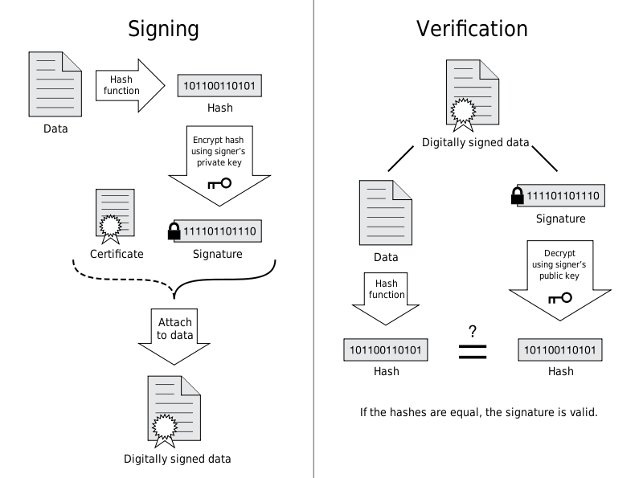
1.Digital Signature

Slide 12
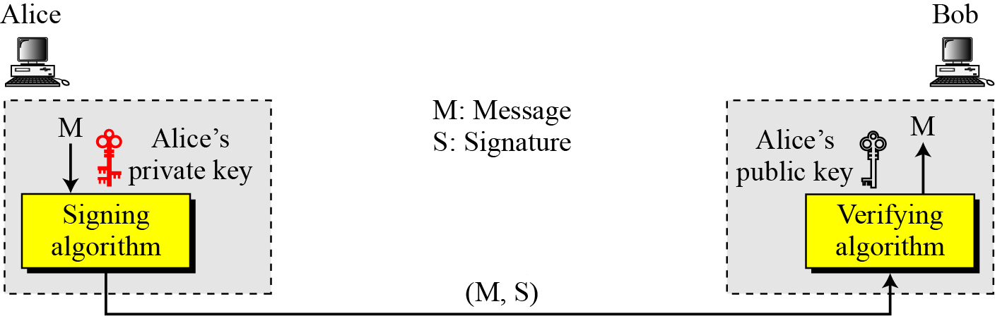

1.Digital Signature
Note
A digital signature needs a public-key system.
The signer signs with her private key; the verifier verifies with the signer’s public key.

Slide 13
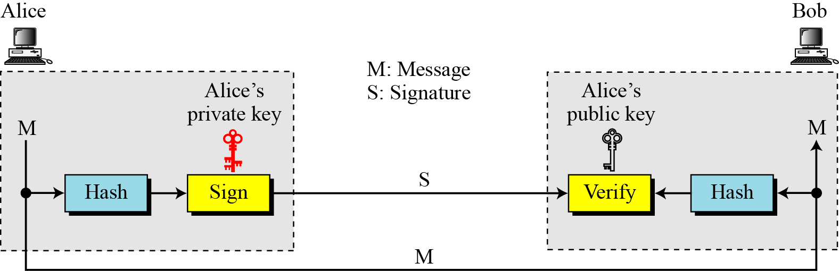
1.Digital Signature
Signing the digest

Slide 14
1.Digital Signature
Digital Signature provide security services as:
Message Authentication
Message Integrity
Non-repudiation
Confidentiality

Slide 15


1. Digital Signature
RSA Digital Signature Scheme
I
n
t
e
r
n
e
t
M
Hash
RSA
RSA
M
M
a
b
Hash

Slide 16
1. Digital Signature
DSS: Digital Signature Standards
I
n
t
e
r
n
e
t
r
Ver
M
H
Sig
r
s
r
s
M
M
r’
k
Random Number
H

Slide 17
Contents
1. Digital Signature
2. Authentication Protocols
3. Pretty Good Privacy

Slide 18
Locations
Slides p18-21 are talking about Authentication Protocols issue which can be found in section 14.1 of the text book

Slide 19
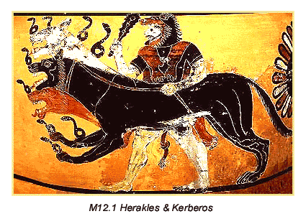
2. Authentication Protocols
Kerberos: Overview
Kerberos (pronounced /kɛərbərəs/) is a computer network authentication protocol, which allows nodes communicating over a non-secure network to prove their identity to one another in a secure manner.
It is also a suite of free software published by MIT that implements this protocol
MIT developed Kerberos to protect network services provided by Project Athena
Several versions of the protocol exist; versions 1-3 occurred only internally at MIT.
version 4 was published in the late 1980s
version 5 appeared as RFC 1510 in 1993

Slide 20




2. Authentication Protocols
AS: Authentication Server
E(K_{AS,C}, (K_{C,TGS} || ID_{TGS} || ID_{tgs}|| TS2 || Lifetime2 || Ticket_{TGS}
2
ID_{c} || ID_{tgs}|| TS1
1
3
4
TGS: Ticket Granting Server
5
C: Client
6
V: Application Server
Kerberos v4

Slide 21
2. Authentication Protocols
A full-service Kerberos environment consisting of
a Kerberos server
a number of clients
a number of application servers
This Kerberos environment requires that
the Kerberos server must have the user’s ID & user’s password
the Kerberos server must share a secret key with each server.
Such an environment is referred
to as a realm
Kerberos: Realms

Slide 22
2. Authentication Protocols
X.509
X.509 is an ITU-T(国际电信联盟) standard for a public key infrastructure(公钥基础设施) (PKI) for single sign-on (SSO) and Privilege(权益) Management Infrastructure (PMI).
X.509 specifies, amongst other things, standard formats for public key certificates(证书), certificate revocation(撤回) lists, attribute certificates, and a certification path validation(确认) algorithm.
For details of X.509, please refer to Section 14.2 or wikipedia

Slide 23
Contents
1. Digital Signature
2. Authentication Protocols
3. Pretty Good Privacy

Slide 24
Locations
Slides p24-28 are talking about PGP issue which can be found in section 15.1 of the text book

Slide 25
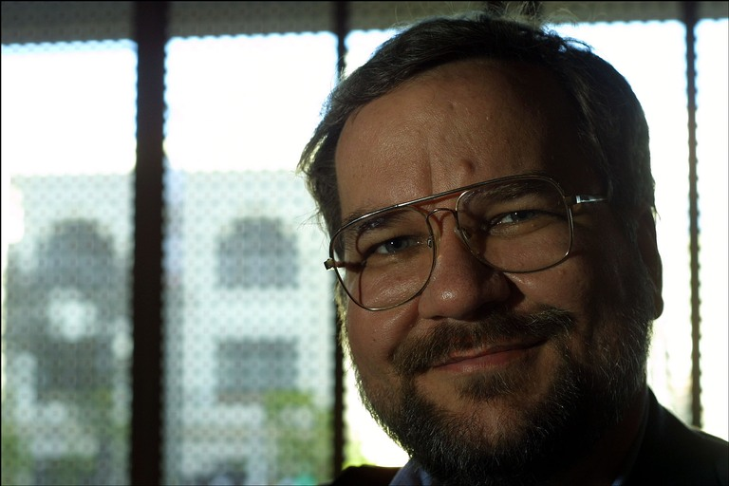
3. Pretty Good Privacy
Philip Zimmerman
Pretty Good Privacy (PGP) is a computer program that provides cryptographic privacy and authentication.
PGP is often used for signing, encrypting and decrypting e-mails to increase the security of e-mail communications.
It was created by Philip Zimmermann in 1991.
PGP and other similar products follow the OpenPGP standard (RFC 4880) for encrypting and decrypting data.

Slide 26
3. Pretty Good Privacy
I
n
t
e
r
n
e
t
M
SHA-1
RSA
RSA
M
M
SHA-1
Authentication using PGP

Slide 27
3. Pretty Good Privacy
N-bit
session
key
I
n
t
e
r
n
e
t
RSA
RSA
M
M
C
C
N-bit
session
key
AES
AES
Confidentiality using PGP

Slide 28
3. Pretty Good Privacy
N-bit
session
key
M
SHA-1
RSA
RSA
M
C
AES
Internet
RSA
C
N-bit
session
key
RSA
M
AES
SHA-1

Slide 29
3. Pretty Good Privacy
For more detail about PGP, please refer to Chapter 15 or wikipedia

Slide 30
Lecture 10: Public Key Cryptography-RSA
Summary
Digital Signature
Authentication Protocol
Kerberos
Pretty Good Privacy

Slide 31
An Introduction to Information Security
Thanks for your attention!
Q&A

